Slide 1
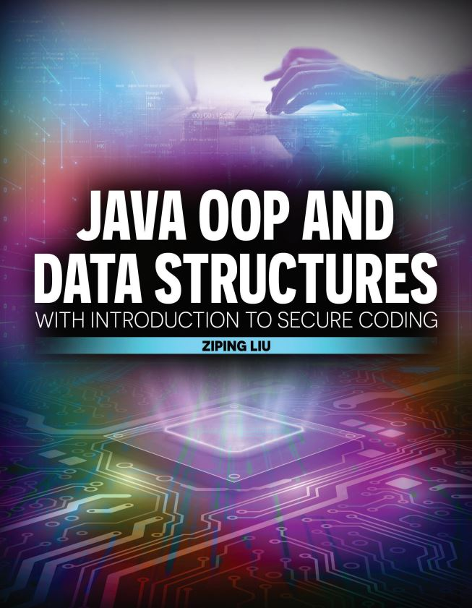

Slide 2

Java OOP and Data Structures with Introduction to Secure Coding Dr. Ziping Liu
Chapter 19 Collections

Slide 3
https://he.kendallhunt.com/product/java-oop-and-data-structures-introduction-secure-coding
Chapter 19 Collections

Slide 4

Chapter Outlines
What is Java Collections framework
Java Collections interface hierarchy
Implementations of Java Collections interfaces
List implementations usage
Queue implementations usage
Set implementations usage
Map implementations usage
Algorithms in the framework

Slide 5
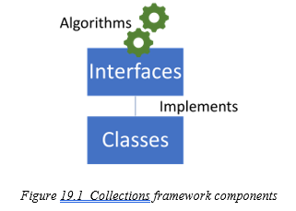
19.1 What Is Java Collections Framework?
a system for representing and manipulating collections
Interfaces: Define a set of operations common to a specific category of data structures, such as the List interface.
Classes: Represent concrete implementations of specific interfaces, such as the LinkedList class.
Algorithms: Provide general methods for performing common operations, such as the sort method.

Slide 6
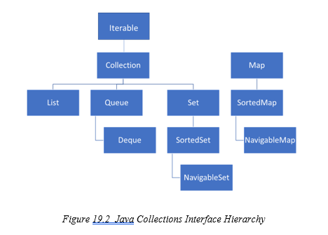
19.2 Java Collections Interface Hierarchy
Two top-level interfaces:
java.util.Collection
java.util.Map (key-value pair)

Slide 7
19.2 Java Collections Interface Hierarchy
Collection:
List: ordered collection and allows duplicates.
Queue: collection with First In, First Out (FIFO) behavior.
Deque: adding and removing elements at both ends (a double-ended queue).
Set: collection that does not allow duplicates.
SortedSet and NavigableSet: providing additional ordering and navigation methods.
Map: SortedSet and NavigableSet providing additional ordering and navigation methods.

Slide 8
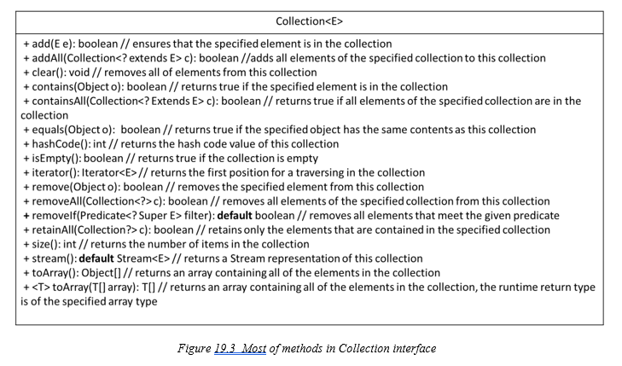
19.2 Java Collections Interface Hierarchy
Operations:
add,
remove
search
traverse

Slide 9
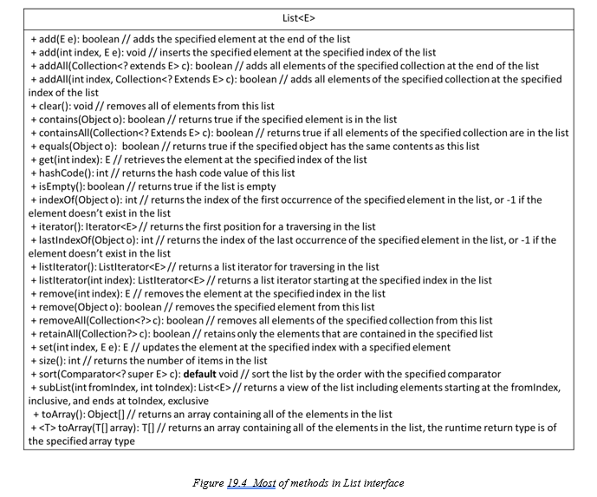
19.2 Java Collections Interface Hierarchy
Operations:
Besides operations from Collection
allow operations using indexing
bidirectional traversal using the listIterator()
allows traversal starting from a specified index
allow sorting

Slide 10
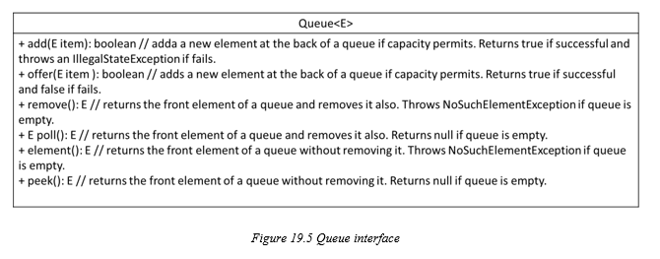
19.2 Java Collections Interface Hierarchy

Slide 11
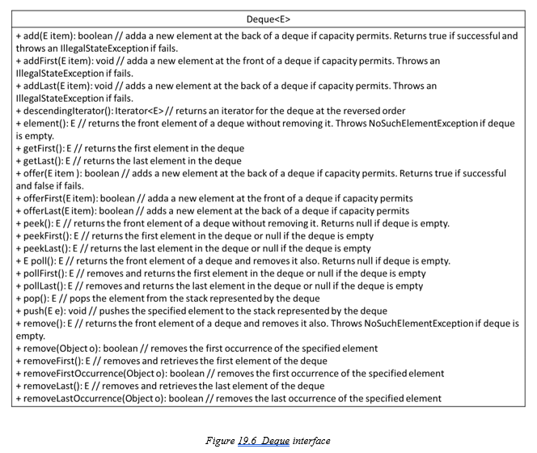
19.2 Java Collections Interface Hierarchy

Slide 12
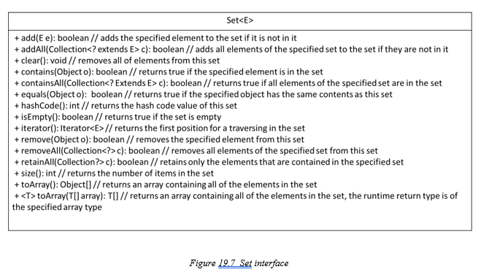
19.2 Java Collections Interface Hierarchy
Operations: adding, removing, and searching for individual elements, as well as forward traversal, but its add operation does not specify where an element will be inserted.

Slide 13
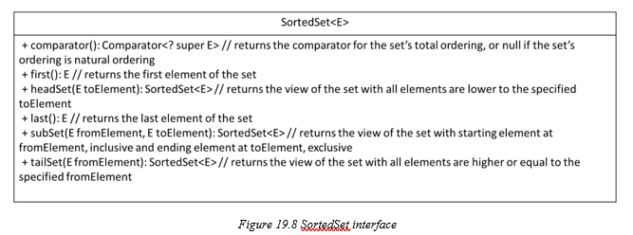
19.2 Java Collections Interface Hierarchy
sorts elements in ascending order using their natural ordering or a comparator specified during creation.
in addition to operations from the Set interface, also provides methods to retrieve the first and last elements as well as a subset of elements within specified ranges.

Slide 14
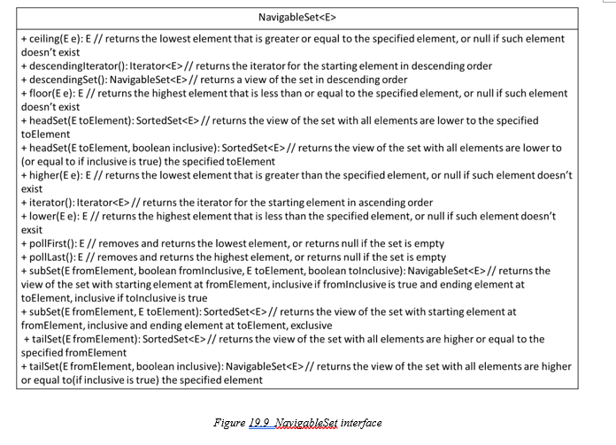
19.2 Java Collections Interface Hierarchy
Operations: in addition to operations from the SortedSet interface, also provide operations:
▸ searching and reporting the closest matches to a specified element
▸ removal of the lowest and highest elements
▸ traversing in descending order or obtaining a descending view of the set

Slide 15
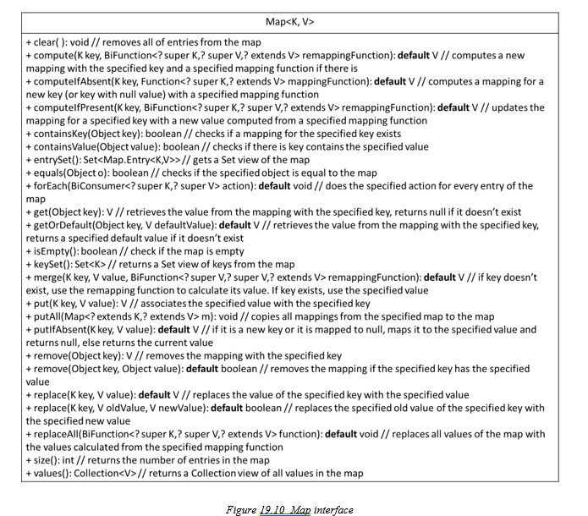
19.2 Java Collections Interface Hierarchy
A key must be unique and is typically immutable.
support for adding, removing, searching, retrieving, and updating elements

Slide 16
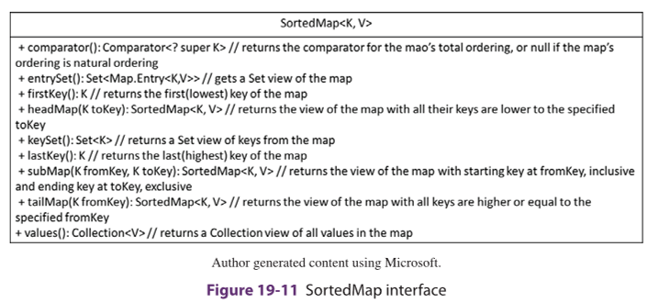
19.2 Java Collections Interface Hierarchy
SortedMap organizes keys in ascending order, using either their natural ordering or a comparator defined by the user.

Slide 17
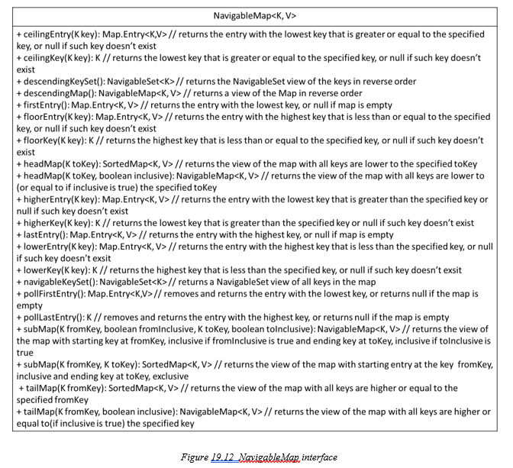
19.2 Java Collections Interface Hierarchy
Operations: in addition to operations from the SortedMap interface, also provide operations:
▸ searching and reporting the closest matches to a specified key
▸ removal of the lowest and highest elements
▸ traversing in descending order or obtaining a descending view of the map

Slide 18
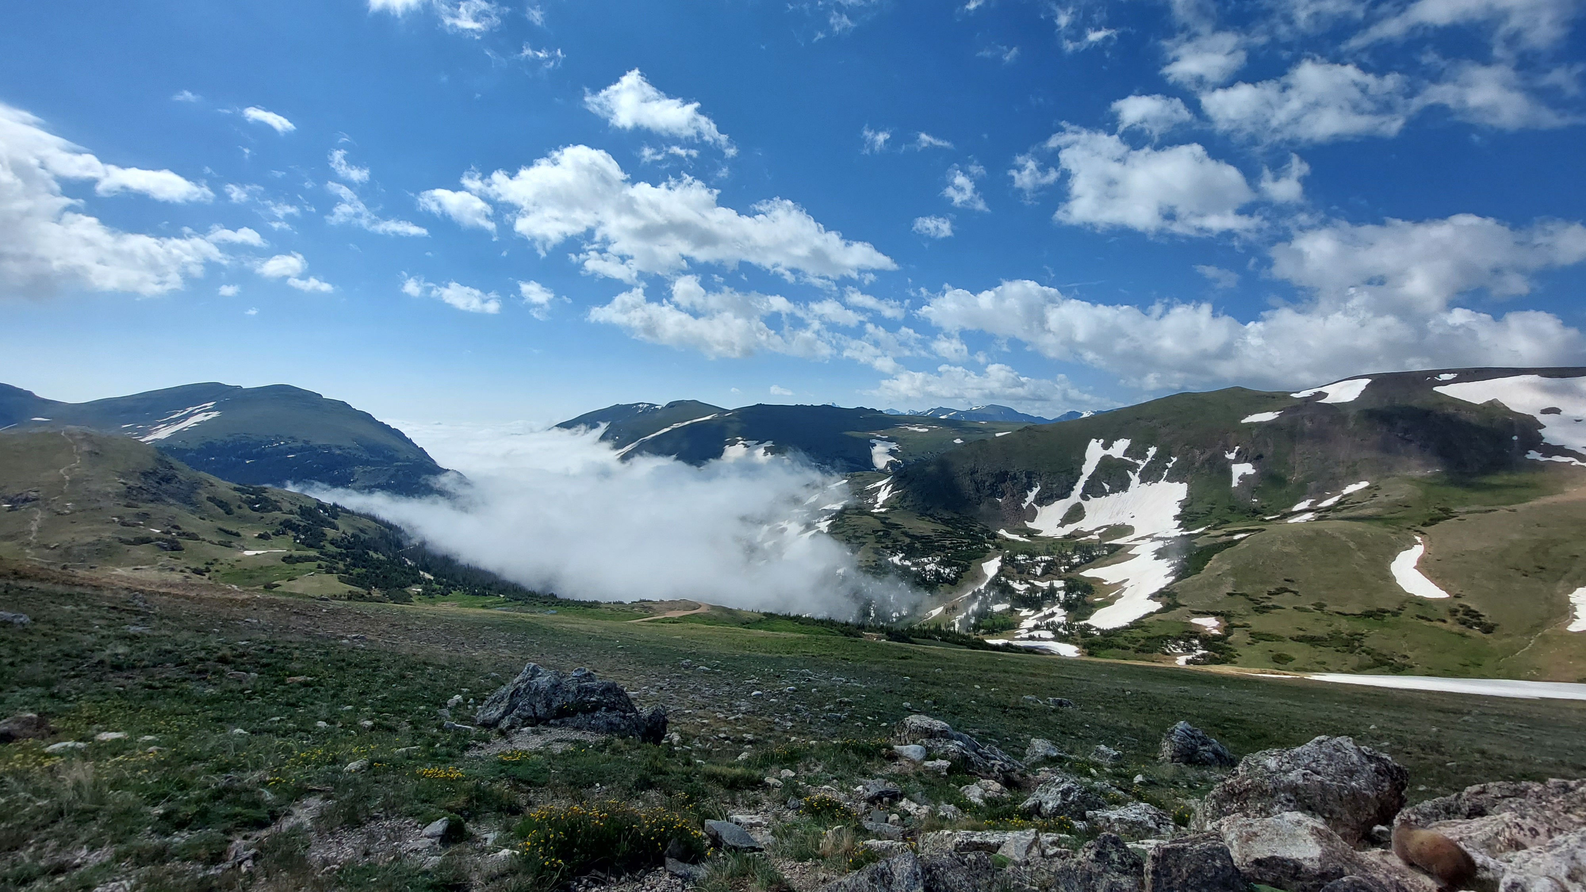

Slide 19
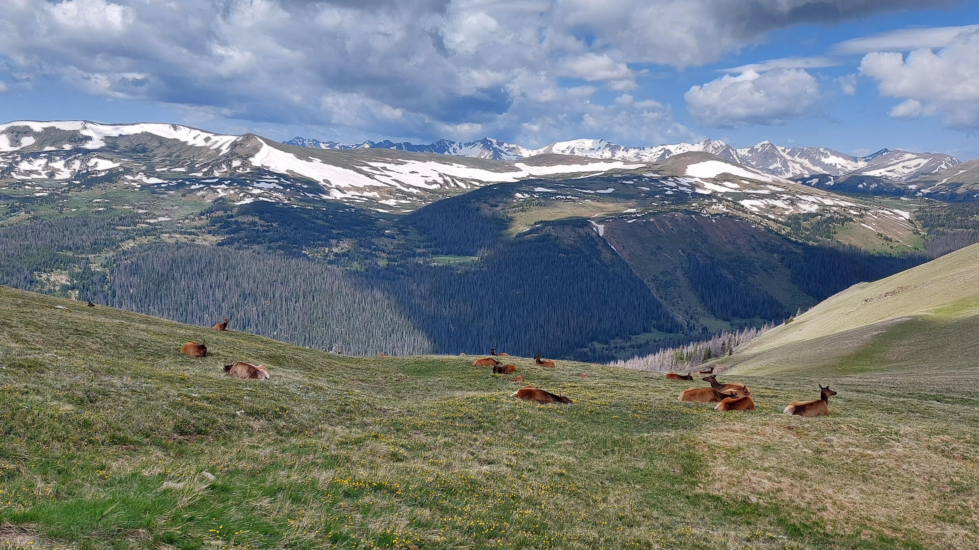

Slide 20
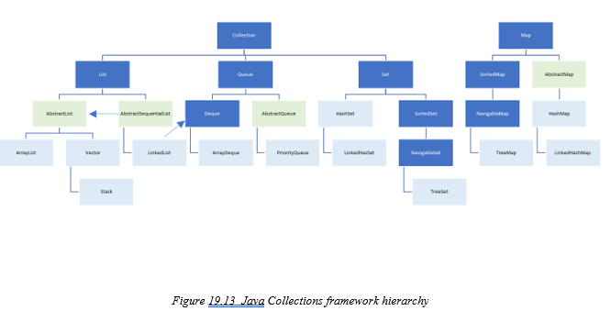
19.3 Implementations of Java Collections Interfaces

Slide 21
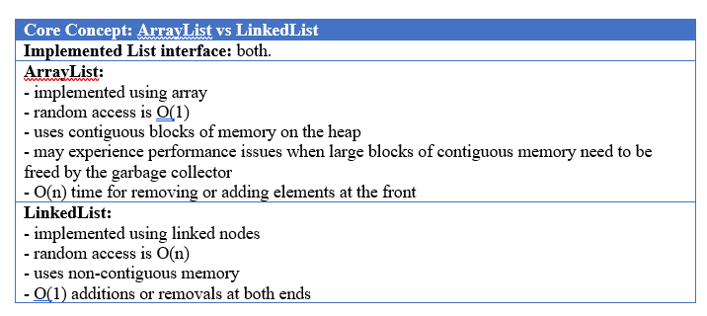
19.3 Implementations of Java Collections Interfaces

Slide 22
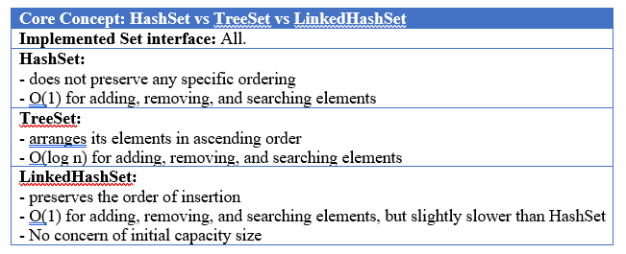
19.3 Implementations of Java Collections Interfaces

Slide 23
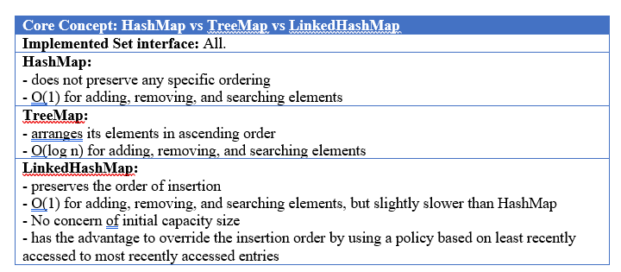
19.3 Implementations of Java Collections Interfaces

Slide 24
19.4 List Implementation Usage
JavaCollectionList example

Slide 25
19.5 Deque Implementation Usage
JavaCollectionDeque example

Slide 26
19.6 Set Implementations Usage
JavaCollectionSet example

Slide 27
19.7 Map Implementations Usage
JavaCollectionMap example

Slide 28
19.8 PriorityQueue Usage
JavaCollectionPriorityQueue example

Slide 29
19.9 Algorithms in the Framework
JavaCollectionApp example

Slide 30
Which National Park is it?
Answer: Rocky Mountain National Park

